Slide 1
PIZZA WORLD
ADVANCED PROGRAMMING LAB-2 PROJECT

Slide 2
The Team
ABHAY GARG
ADITI NEGI
181B007
181B013
Project Faculty - Dr. Prateek Pandey

Slide 3
Introduction
Task
To solve real world problems using design pattern
Idea
To prepare different types of pizzas

Slide 4
The Problem Statement
We have a Pizza shop which makes two types of pizzas one is Italian and other one is Veggie. In both types of pizzas we provide three types of condiments : Oil, Vinegar, Butter. We offer 3 types of meat(Pork, Pepperoni, Chicken) and several types of veggies. Customer can order any pizza based on their preference.

Slide 5
Task
Our project will make the pizza according to the choice of customer.

Slide 6
Design Pattern Used
Template Method Pattern...

Slide 7
Template Method Pattern
In Template pattern, an abstract class exposes defined way(s)/template(s) to execute its methods. Its subclasses can override the method implementation as per need but the invocation is to be in the same way as defined by an abstract class. This pattern comes under behavior pattern category.

Slide 8
Importance
The template method is used for the following reasons :
Let subclasses implement varying behavior (through method overriding)
Avoid duplication in the code, the general workflow structure is implemented once in the abstract class's algorithm,
necessary variations are implemented in the subclasses.

Slide 9
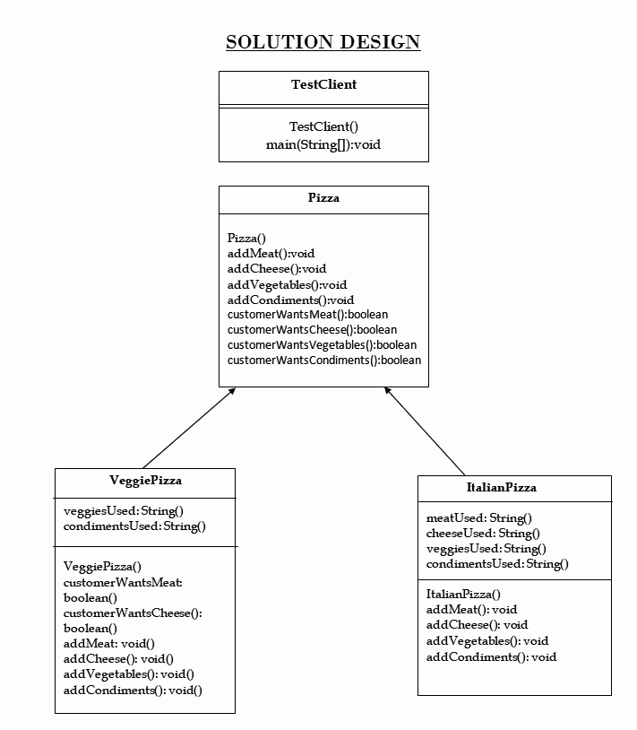

Slide 10
Screenshots...

Slide 11
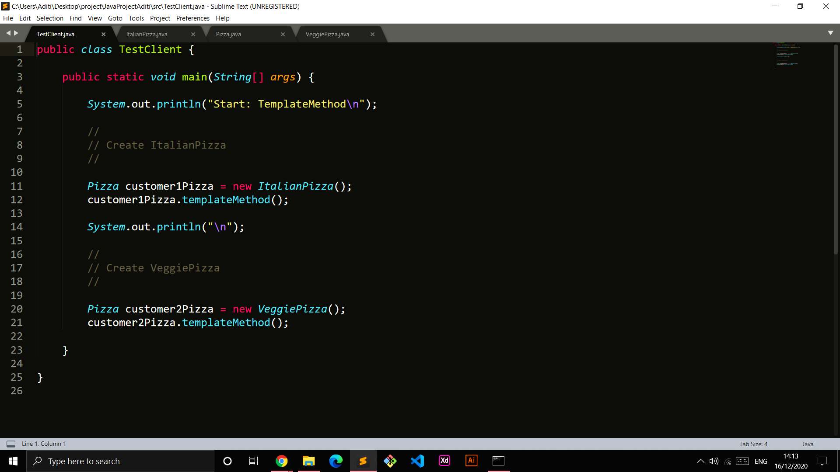
MAIN CLASS

Slide 12
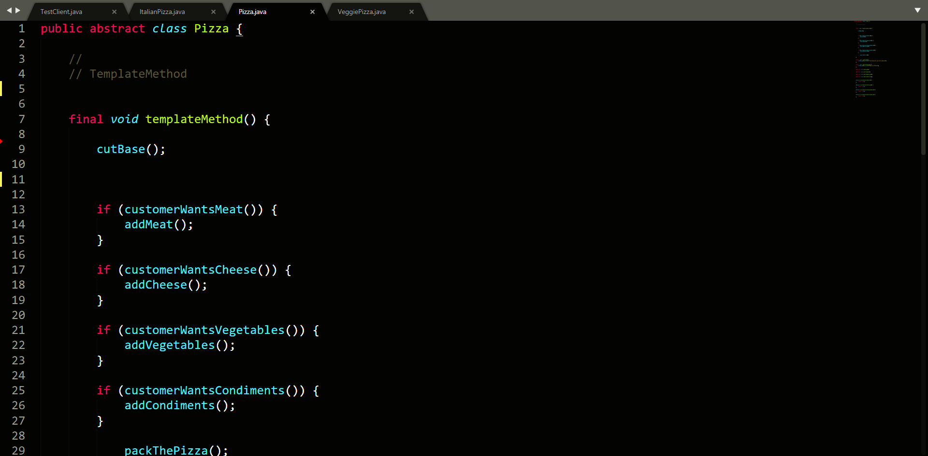
PIZZA CLASS

Slide 13
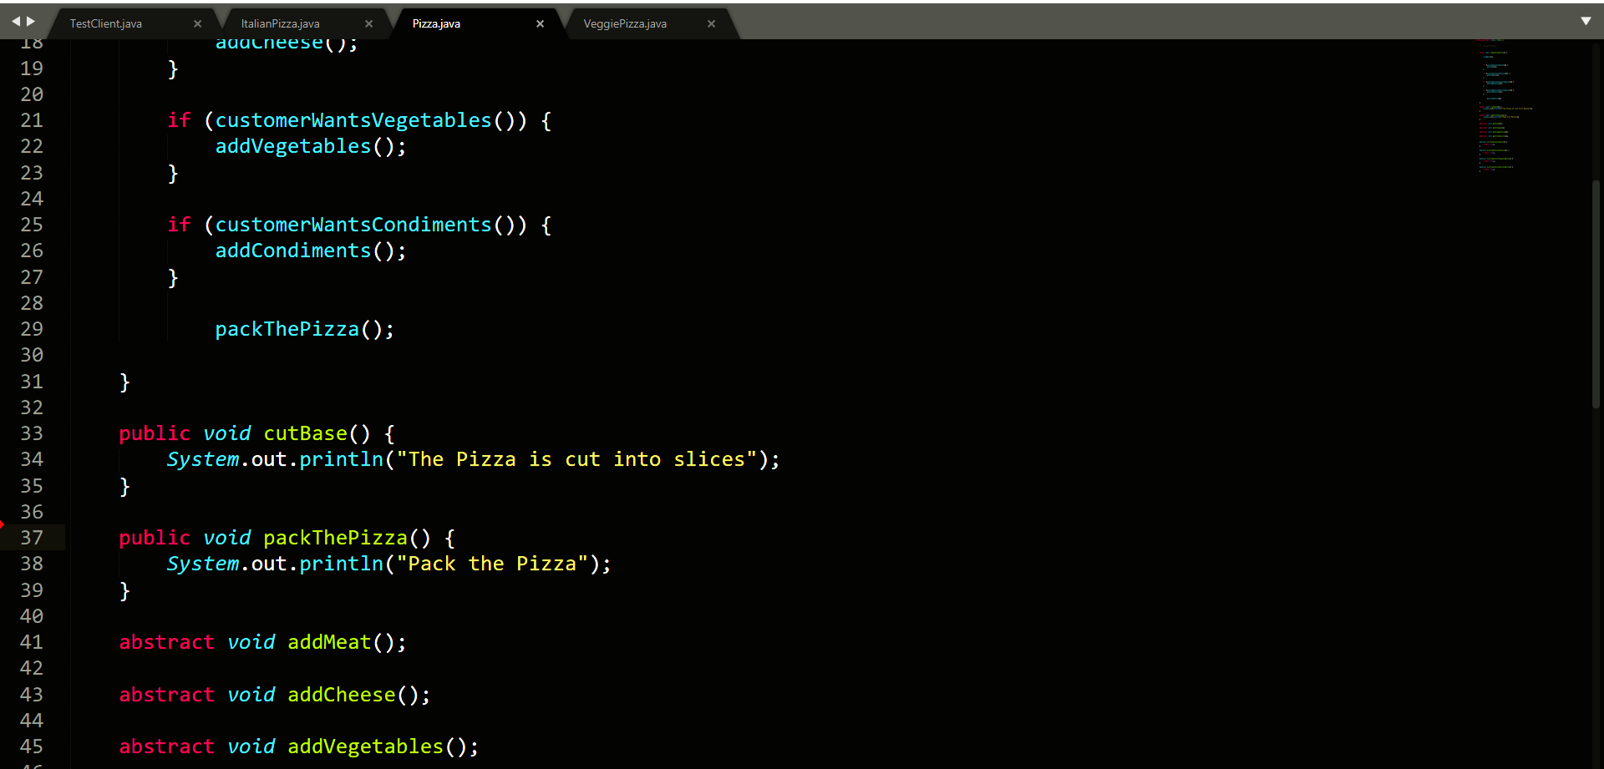
CONTINUED….

Slide 14
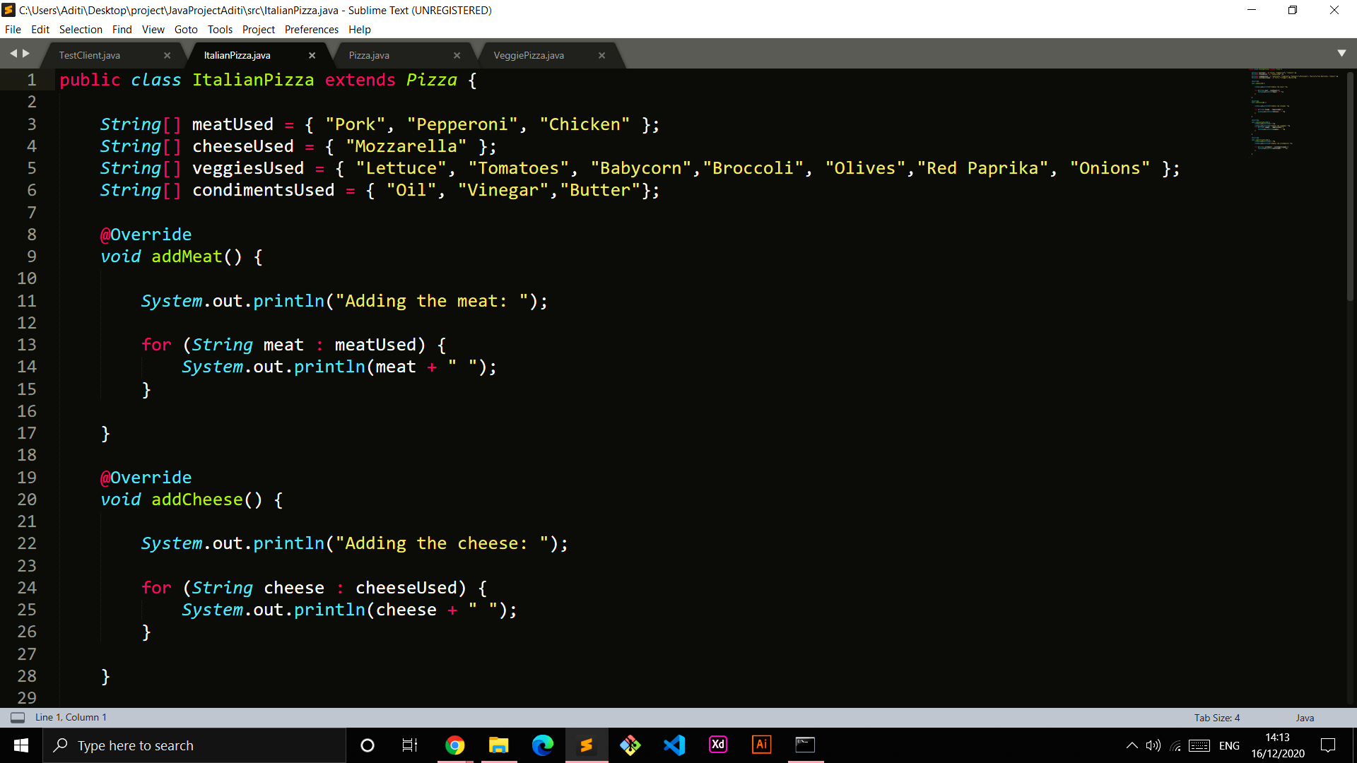
ITALIAN PIZZA CLASS

Slide 15
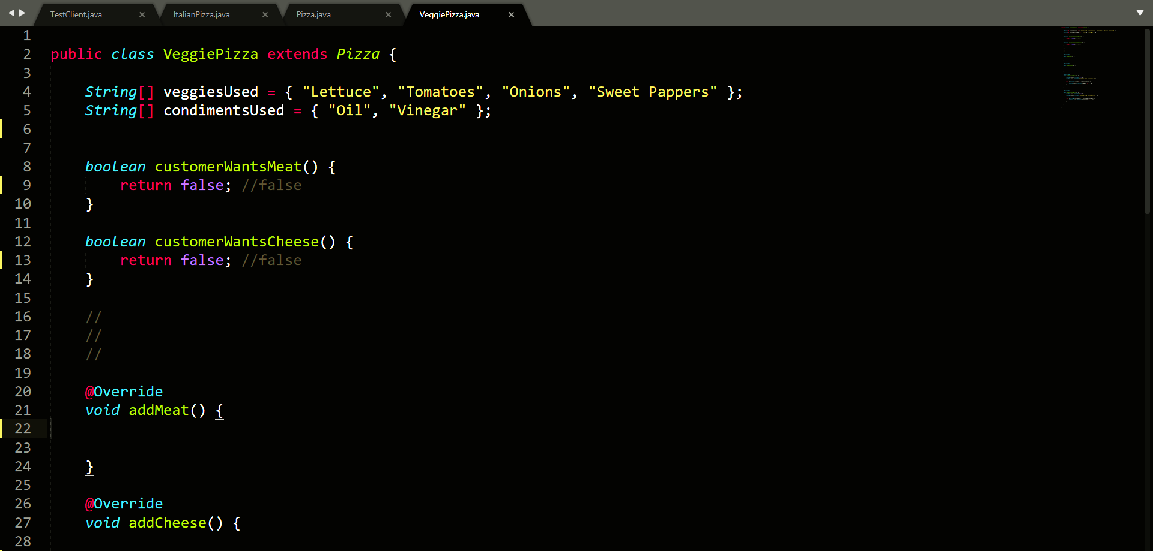
VEGGIE PIZZA CLASS

Slide 16
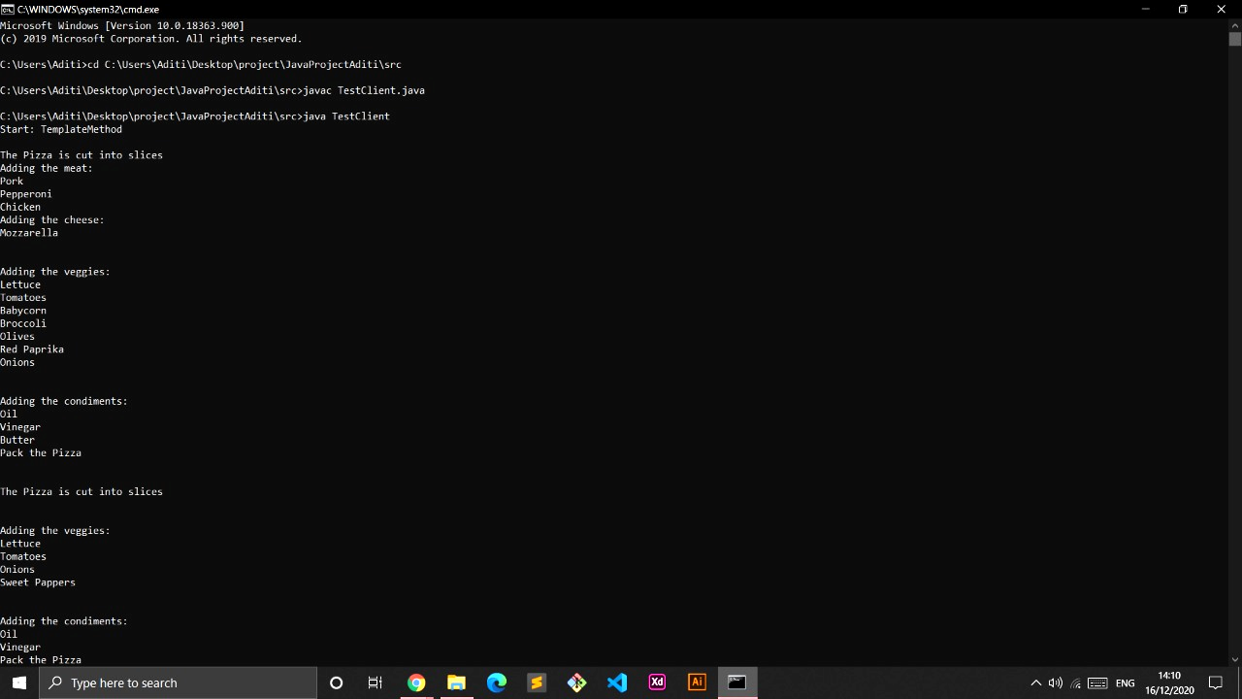
OUTPUT

Slide 17
THANK YOU !

